Slide 1
Introduction to Computer Systems
Tanzir Ahmed CSCE 313 Summer 2020

Slide 2
Lecture Outline
Part1
Course Objectives and Outcome
Logistics
Part2
Course Context
Intro to OS

Slide 3
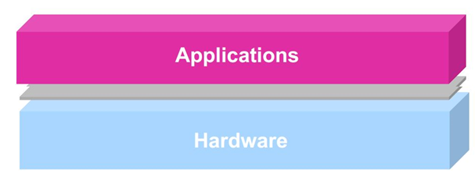
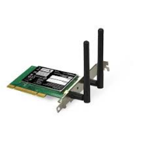
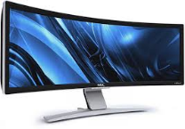
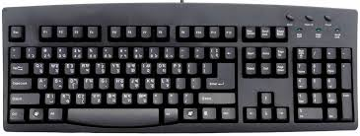

Essence of the Course
To learn the software interface to the Operating Systems
Why interface with OS? Or Why cannot the application software do everything by itself?
What is an OS anyways?
Let us look at a typical program in isolation (i.e., no other programs running) that uses CPU, memory, and other devices as it wishes
Processor
Memory
INT
INT
Packet I/O
Character O/P
Block I/O
storage

Slide 4
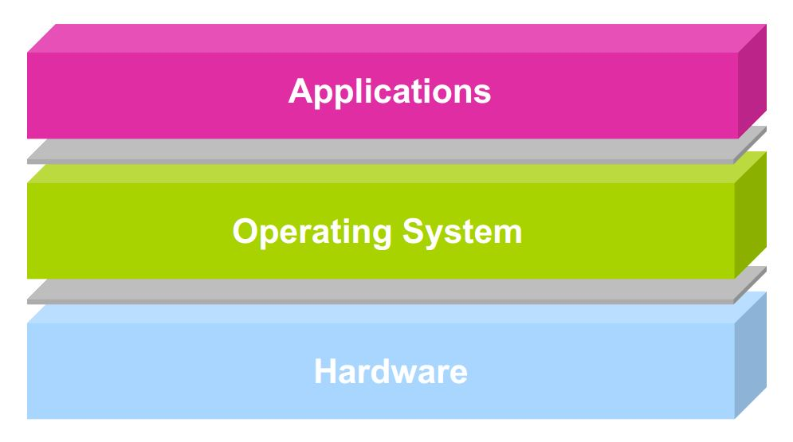


Essence of the Course
But the situation is more complicated in reality because of many application programs running at the same time:
There has to be an agent that controls sharing of resources and makes peace between
App 1
App 2
App 3
App 4
Our discussions focus
Processor
Memory
INT
INT
Character O/P
Block I/O
Packet I/O
storage

Slide 5
Essence of the Course
This is, NOT an Operating System (OS) course
Can take CSCE 410: Operating Systems
However, the content will discuss OS quite a bit from a programmer’s perspective, because:
We want to harness OS basics to write high-performance, inter-dependent, and hardware and OS-aware applications
We can also borrow techniques used in OS as a huge software and apply those to everyday software development practices
For instance, the concept of timers in OS is crucial for Asynchronous programming required in real-time systems

Slide 6
Why do we need OS in 313?
Some of you will design and build OS’s or components of them
Perhaps more now than ever, because there are many different OS’s targeted for specific devices (e.g., robots, servers, signal lights, cameras, vehicle infotainment systems)
Many of you will create systems that utilize the core concepts in operating systems
The concept of “hierarchy” and “abstraction” are all too imp
Whether you build software or hardware
The concepts and design patterns appear at many levels
All of you will build applications, etc. that utilize operating systems
The better you understand their design and implementation, the better use you’ll make of them.

Slide 7
Learning Outcome
In this course, you will learn how to use different OS services and features:
What is an operating system; its components; how it works
Execution of a program; function calls; interrupts; system calls; process control
File system
Concurrency and Synchronization
Inter-Process Communication (IPC)
Network/socket programming
Network Threats/Security Basics

Slide 8
CSCE 313 Instruction Team
Instructor: Dr. Sarker Tanzir Ahmed
Instructional Assistant Professor
Background: PhD from TAMU CSE in High Performance Computing, Big Data, Web Crawling
Teaching Assistant:
Frank Wan (frankwanbear@gmail.com)
PhD student, experience teaching this course

Slide 9
Textbook, Reference Books
Text:
T1: Operating Systems: Principles and Practice, Second Edition, Thomas Anderson and Michael Dahlin, Recursive Books, 2014.
T2: Operating Systems: Three Easy Pieces, Remzi H. Arpaci-Dusseau and Andrea C. Arpaci-Dusseau, available online at: http://pages.cs.wisc.edu/~remzi/OSTEP/
Reference:
R1 (Main): Operating Systems – Internals and Design Principles, William Stallings, Ninth Edition
Secondary: Understanding Unix/Linux Programming A Guide to Theory and Practice, Bruce Molay, Pearson Education Inc., 2003
Other Interesting Readings
Computer Systems: A Programmer's Perspective, Randal E. Bryant and David R. O'Hallaron, Prentice Hall, 2011

Slide 10
How Success will be Measured
The course will have several quizzes/mini assignments, two exams, and a series of Programming Assignments (PA). The grade allocation is as follows:
Total 100 points
Quizzes (4-5): 15 points (given about one every 1 week)
2 Exams: Midterm (15%) and Final (20%), both take-home, open-note
5 Programming Assignments: 50 points (about 1 every week)
The grading scale is as usual (i.e., similar to other courses)

Slide 11
Late Policy
Pas
Penalty: Unless stated otherwise, lateness is penalized as a simple linear function of hours late
0.833% /hour of your score
As a result on late submissions you loose:
20% / day
100% if more than 5 days late

Slide 12
Method of Teaching
Everything (e.g., Lectures, PA’s, Quizzes, Exams) will be available for asynchronous reception
You watch the lecture videos at your convenience
Quizzes and PA’s will have specified release dates and submission deadlines
The midterm and final exam each be given one day from the release to complete. The dates will be announced soon
However, we will hold synchronous sessions during a given time for a) lectures, b) labs
Lecture times are 7-8:30 pm TR
Lab times are TBD
Piazza will be the main place of discuss

Slide 13
Lecture Outline
Part1
Course Objectives and Outcome
Logistics
Part2
Introduction to Computer Systems
Background – What we know already
What we are going to learn
OS Intro

Slide 14
Background – From 312
Program counter / Instruction pointer
CPU
Arithmetic Logic Unit
PC/IP
Registers
ALU
Stack Pointer (points to data)
SP
I/O bridge
Main Memory
BUS Interface
I/O BUS
….
Keyboard, mouse
Display
Network
Disk
Simplified hardware organization of a typical system

Slide 15



Program Execution
Processor
Memory
INT
Character O/P
A program is a collection of instructions
Simple Instruction execution model:
CPU supports a small set of instructions
Aka. Instruction set
To run a single program, all we have to do is load a program at addr=0 in the memory, and then unleash the above model
We must promote this model with ability to run multiple programs
Let us start with a little bit history first
Block I/O
INT
Packet I/O
storage
NO
Fetch Instruction @ PC (from memory)
End of program
YES
Start
Execute Instruction @ PC
Increment PC
Stop Execution

Slide 16
A Short Historical Tour
First Generation Computer Systems (1949-1956):
Single user: writes program, operates computer through console or card reader / printer
Absolute machine language
No concept of an Operating Systems
Hardware simple, but not the programs written on it
Programmer must compile, load, and run program by hand before even putting into the machine
repeat
Fetch Instruction @ PC (from memory)
End of program
Start (PC=0)
Execute Instruction @ PC
Increment PC
Stop Execution

Slide 17
Second-Generation Computers (1956-1963)
Automation of Load/Translate/Load/Execute
Batch systems
Monitor programs
Problem: Resource management and I/O still under control of programmer. Issues??
Memory protection, security etc.
What if one program crashes
Addr = 0
Addr = x
Monitor/OS
user program area
device drivers
control card interpreter
job sequencer / loader
No
No
Start (PC=0, load monitor)
Fetch @ PC and execute, increment PC
Jump to Loader, load the next program at addr=x, set PC=x
End of program
End of all programs
Yes
Yes
Stop Execution

Slide 18
Third-Generation Computer Systems (1964-1975)
Problem with batching: one-job-at-a-time
Solution: Multiprogramming
Job pools: have several programs ready to execute
Keep several programs in memory
New issues:
Job scheduling,
Memory management
Protection
sequential:
CPU
I/O
Job1
CPU
Job2
better:
Job3
I/O
Monitor
Job1
Job2
JobN
*Prerequisite for multiprogramming is Direct Memory Access (DMA): a sub-component of CPU that can drive I/O operations w/o involving CPU

Slide 19
Time Sharing (mid 1960s on)
Remote interactive access to computer: “Computing as Utility”
OS interleaves execution of multiple user programs with time quantum
CTSS (1961): time quantum 0.2 sec
User returns to own the machine
New aspects and issues:
On-line file systems
resource protection
virtual memory
sophisticated process scheduling
Advent of systematic techniques for designing and analyzing OSs.

Slide 20
Multiprogramming(MP)/Time Sharing (TS) – Implementation?
Some changes are needed in the following model to support MP and TS:
How do extend this to support either MP or TS
Clearly, we need a mechanism to “kick” a program out at some point from the CPU
And “bring it back” later into the CPU
In summary, we need “Asynchrony” in programs
repeat
No
Fetch Instruction @ PC (from memory)
End of program
Start
Execute Instruction @ PC
Increment PC
Yes
HLT

Slide 21
When to Kick-out a Program
For time sharing
Conceptually, what we need is this:
Here come “Interrupts”
For multiprogramming
Source: W. Stallings book

Slide 22
The Computing Model Changes
Computing Model to Support Interrupts
Source: W. Stallings book

Slide 23


A Modern Computer System
user2
user3
user1
user2
user3
user4
user1
user4
Application Programs/Processes
Compilers
Linker
Loader
return
System calls,
Exceptions
Memory Manager
Device Manager
Privileged
Operations
Processor
Memory
INT
INT
Character O/P
Block I/O
Packet I/O
storage
Notes:
This picture shows a broader generalized view of hardware and software stack in a modern computer system. Users write application programs. When many programs are running on a concurrent system, a system software known as the operating system is needed to play the role of a referee, illusionist, and glue. We will learn the specifics in coming lectures. But for now, it suffices to say that a modern computer system with multiple interacting hardware devices and software needs a controlling system software to keep things running efficiently and correctly.

Slide 24
What is an operating system?
Special layer of software that provides application software access to hardware resources
Convenient abstraction of complex hardware devices
Protected access to shared resources
Security and authentication
Communication amongst logical entities
appln
appln
appln
OS
Hardware

Slide 25
What is an OS? – Virtualization View
Many programs share the computer simultaneously
How to make this sharing easy?
Or not a nightmare to the app programmers?
Let us consider the following example code
#include <iostream>
using namespace std;
int main (int ac, char** av){
for (int i = 0; i < 10; i++){
cout<<"hello from "<<av[1]<< endl;
sleep (1);
}
}

Slide 26
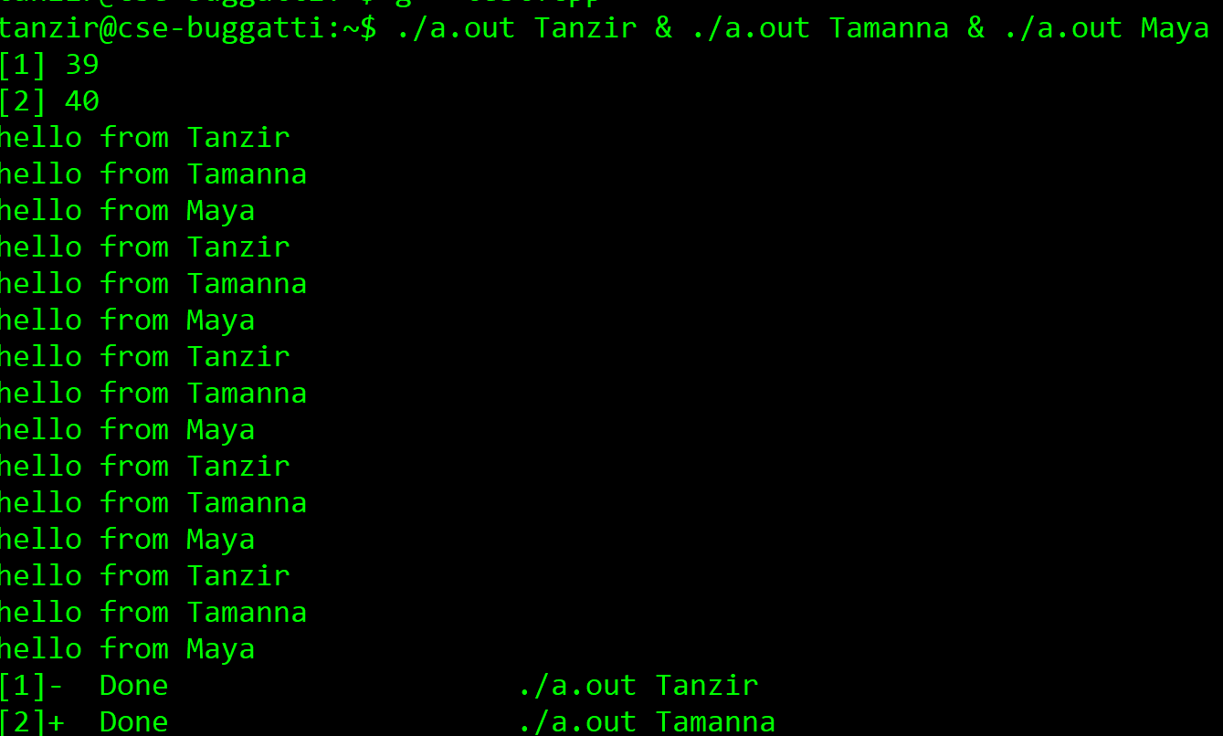
CPU Virtualization
When 3 instances are run together, the following happens:

Slide 27
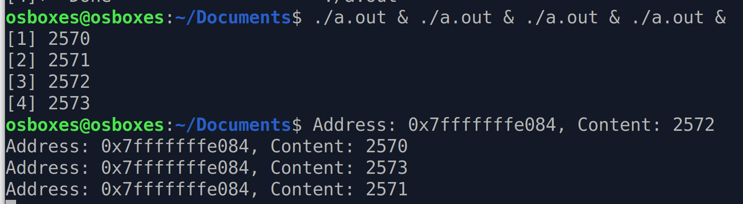
Memory Virtualization
Every program gets its own ID, even the same program running multiple times
#include <stdio.h>
#include <unistd.h>
#include <stdlib.h>
int main (){
int p = getpid();
sleep (1);
printf ("Address: %p, Content: %d\n" , &p, p);
}
Sleeps for a sec
These are coming from the shell, showing process IDs
Same address, different content

Slide 28
What’s the OS’s Role?
In a single word: Virtualization
The OS is hiding the physical machine and giving each program a virtual machine to play with
Each program can be agnostic of what else is going on in the System
If apps wanted to know and manage all that, their job would be a lot more difficult
appln
appln
appln
OS
Virtual Hardware Interface
Hardware

Slide 29



What is an Operating System?
Referee
Manage sharing of resources, Protection, Isolation
Resource allocation, isolation, communication
Illusionist
Provide clean, easy-to-use abstractions of physical resources
Infinite memory, dedicated machine
Masking limitations, virtualization
Glue
Common services
Drivers for common devices, File System, Window System, Networking Stack
Sharing, Authorization
Look and feel

Slide 30
Goals of an Operating System?
The OS controls and coordinates the use of system resources.
Primary goal: Provide a convenient environment for a user to access the available resources (CPU, memory, I/O)
Provide appropriate abstractions (files, processes, ...)
“virtual machine”
Secondary goal: Efficient operation of the computer system
Make sure that the OS does not kill performance too much
Efficient Resource Management
Multiplexing: Create illusion of multiple resources from a single resource
Scheduling: “Who gets the resource when?”

Slide 31
What an operating system is not
OS is not a language or a compiler
OS is not a command interpreter / window system
OS is not a library of commands
OS is not a set of utilities

Slide 32
OS Challenges
Reliability
Does the system do what it is supposed to do?
Are all your files consistent after a restart?
Challenging in a heterogeneous app ecosystem (bugs, viruses etc)
Availability
What portion of the time is the system working?
Does your system restart all the time?
Can you think of a system that is reliable but not available, or vice versa?
Notes:
An excuse to define some terms!

Slide 33
OS Challenges
Security
Can the system be compromised by an attacker?
No large system can be completely secure
Bugs
Developer backdoors
Programs still need to interact (complete fault isolation not possible)
Privacy:
Data is accessible only to authorized users
I cannot access your CSE network drives
An OS needs both a security policy and an enforcement mechanism
Notes:
An excuse to define some terms!

Slide 34
OS Challenges
Portability
OS’s take many developers and in order of years to develop. Therefore, they should stay portable across application and hardware level changes
Performance
The market for OS is competitive
OS’s with suboptimal performance do not stand a chance
An OS can be good for some type of programs, while not great for some others
Compilers Web Servers Databases Word processor Web Browsers
Abstract Virtual Machine (AVM)
Operating System
Hardware Abstraction Layer (HAL)
x86 ARM PowerPC 10/100/1000MBps LAN Onboard/External Graphics GPUs

Slide 35
Challenges in Modern OSs
Smart Phones
Responsiveness, security, battery life related to CPU cycles
Embedded Systems
Reliability, efficiency, security
Web Servers
Supporting billions of requests/sec efficiently and safely
Virtual Machines
Low overhead and proper h/w virtualization
Server Clusters
Hide the clustering details from application programs

Slide 36
Challenges in Tomorrow’s OSs
Existing challenges would be more critical
OSs controlling future self driving cars, or traffic lights need to have absolutely reliability, security, and efficiency
The future of OSs is intertwined with that of emerging computing hardware
Giant-scale data centers
Increasing numbers of processors per computer
Newer portable devices
Very large-scale storage

Slide 37
Credits
Slides are based on Dr. Aakash Tyagi and Dr. Riccardo Bettati’s lectures
Programming Assignments are mostly taken from Dr. Bettati
Other sources are credited along the way

